Slide 1
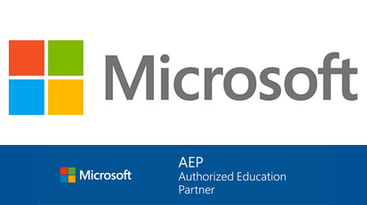

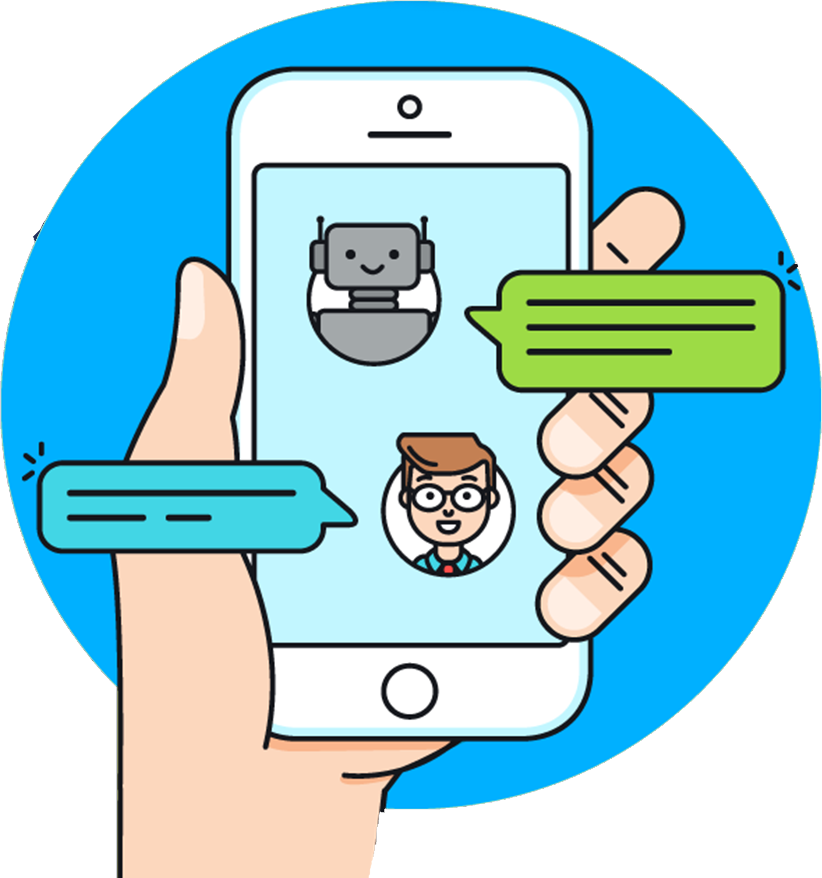

Slide 2
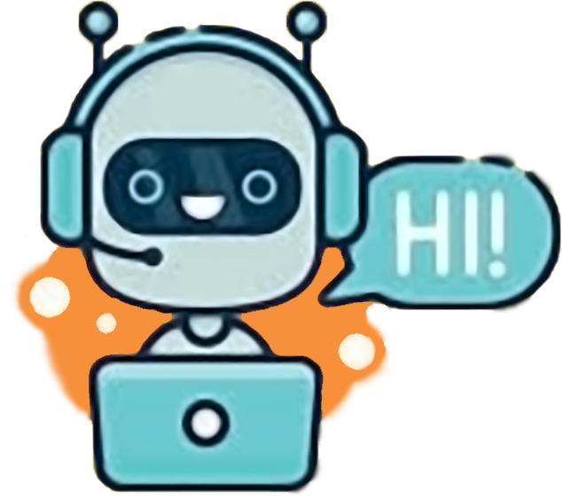
INTRODUCTION
A chatbot (also known as a
talkbot, chatterbot, Bot, interactive
agent , IM bot , or Artificial
Conversational
Entity) is a computer
program or an
Artificial Intelligence
which conducts a conversation via
auditory or textual methods.

Slide 3
OPERATING ENVIRONMENT
CPU cores : Minimum 2 cores
Recommended
memory : 2GB for Windows
Disk Space : 50MB
Additional : Requires PyCharm IDE,
Python interpreter
on Windows

Slide 4
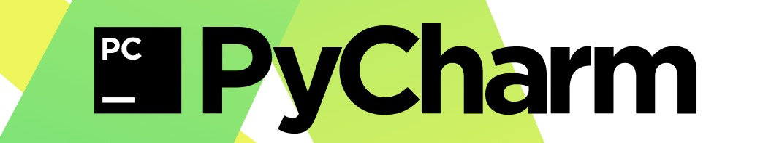
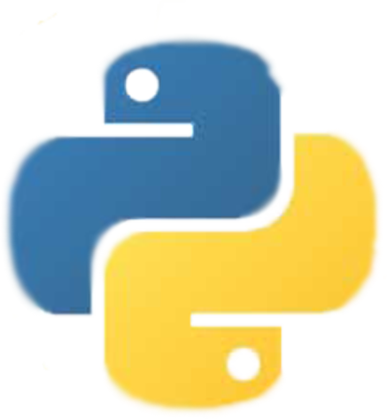
SOFTWARE AND HARDWARE
REQUIREMENTS
Technical details:
Language : Python
Software requirements:
PyCharm Integrated Development Environment (IDE)
Python Interpreter
Hardware requirements:
Minimum 1GB of RAM
50MB of free hard diskspace
Monitor
Keyboard
Mouse

Slide 5
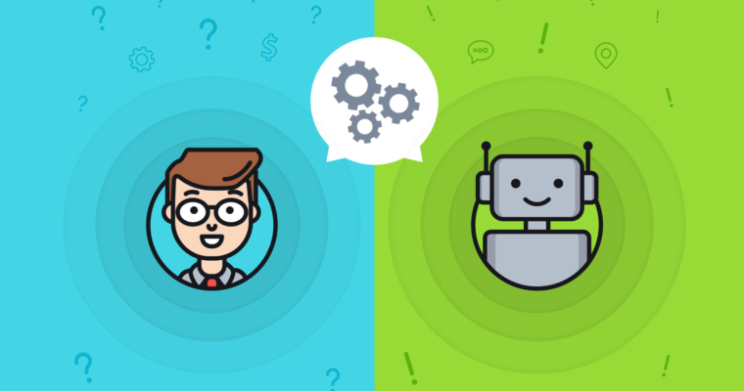
MODULES/LIBRARY
The following are the main modules of the project:
NTLK - Natural Language Toolkit :
Natural Language Processing with Python NLTK is one of the leading platforms for working with human language data and Python, the module NLTK is used for natural language processing. NLTK is literally an acronym for Natural Language Toolkit.
NTLK.chat :
NLTK has a module, nltk. chat, which simplifies building these engines by providing a generic framework. In order to interact with these engines we can just load these modules in our Python program and invoke the demo() function.
REFLECTION in Python :
Reflection refers to the ability for code to be able to examine attributes about objects that might be passed as parameters to a function.

Slide 6
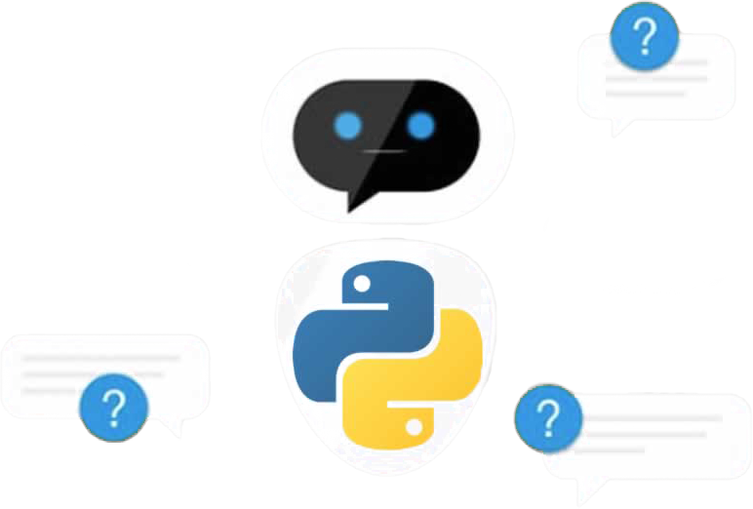
CONCLUSION
Chatbots are intelligent agents that engage in a conversation with the humans in order to answer user queries on a certain
topic . Amazon’s Alexa ,
Apple’s Siri and Microsoft’s
Cortana are some of the
examples of chatbots.

Slide 7
Thank You

